Slide 1

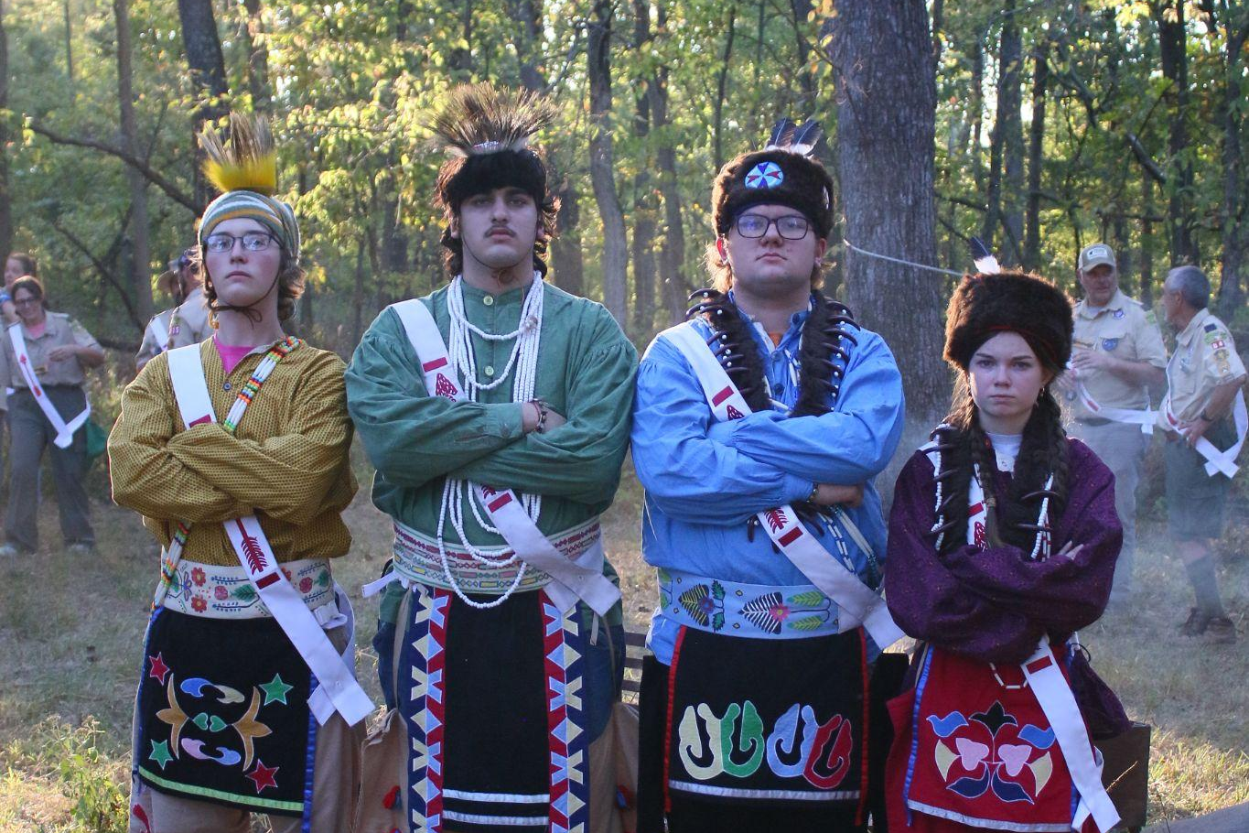
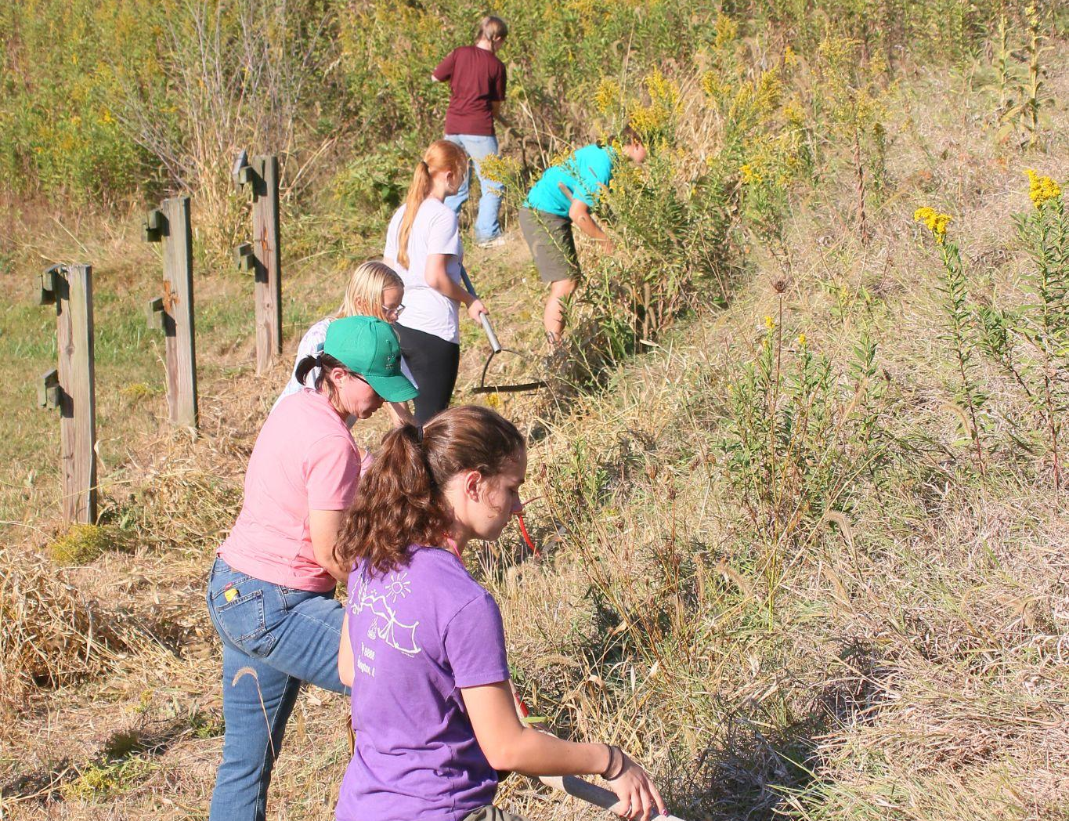
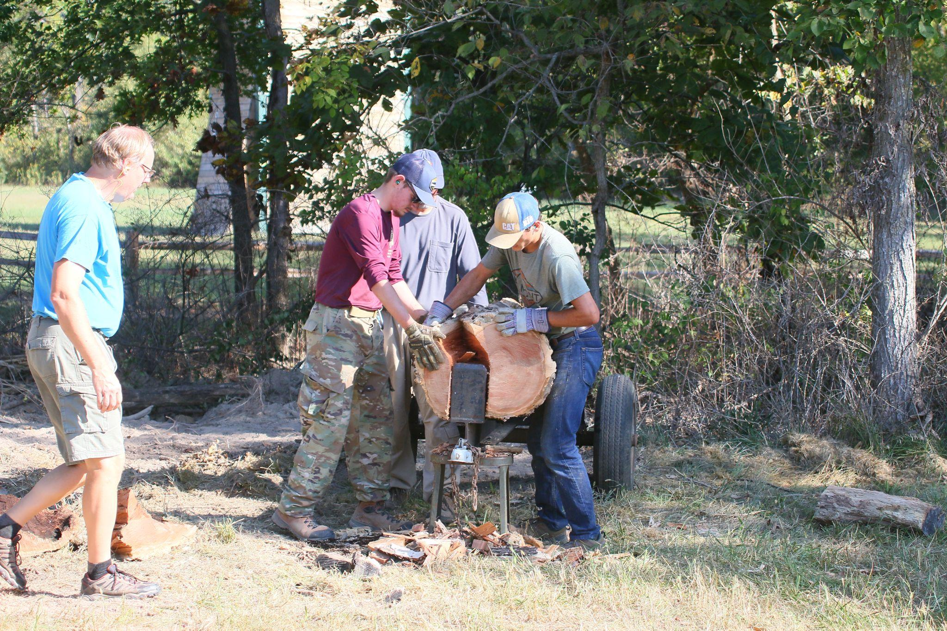
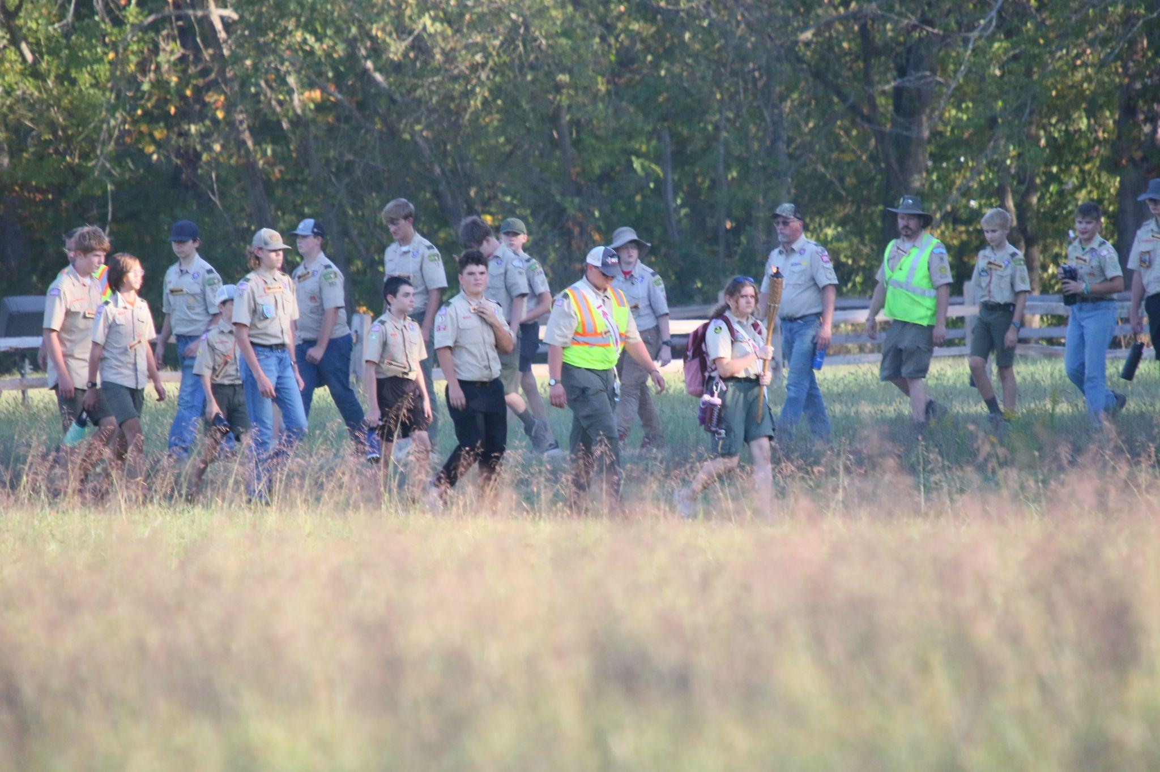
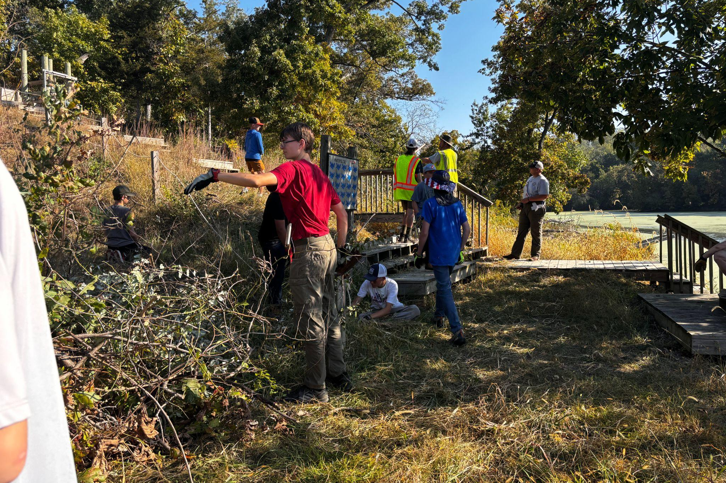
Fall Fellowship Attendees Provide Service at Camp
It’s autumn arrowmen, which means the temperature is falling and so are the leaves. Because of this Ingersoll Scout Reservation needs to be prepared for a long Winter. Many arrowmen completed their Ordeal and maybe even their Brotherhood. A few even accomplished the highest honor, Vigil. Congratulations to all! A big thank you to everyone who helped out and made this weekend a success.
As their day of service, Ordeal Candidates help by clearing weeds (To the left). Our Ceremonialists preparing to complete an Ordeal Ceremony (Above).
Arrowmen doing their cheerful service by cutting wood (To the right).Ordeal Candidates walking to the Ordeal Ceremony (below).
More Cheerful service shown by Ordeal Candidates (Below).
October 2025

Slide 2
Letter From the Chief
Hello fellow arrowmen,
I want to thank you all for the honor to serve as your 2025-2026 lodge Chief of Wenasa Quenhotan. I am very grateful for this opportunity, and am excited to offer my efforts this year towards bettering our lodge.
This year, I want to make sure that our lodge not only succeeds, but thrives. You can rest assured that our LEC is hard at work to bring you events loaded with opportunity to grow as leaders in fellowship and in service. Coming soon, I hope to see everyone at our FREE WQ4U event! Be on the lookout for more information, and make sure to register on our website!
Above all, I urge all arrowmen to seek their place in the lodge. Whether you choose to serve on the LEC, help out at events, or even just encourage scouts in your home units to become involved in the OA, you all have the ability to make a difference. Everyone can bring ideas to the table, so I want you all to feel welcome to share them. With the help of each of you, I know that we can make this a great year for Wenasa Quenhotan.
If you ever have any questions and/or are looking to get involved with the lodge or LEC, feel free to email me at: chief@wq23.org
Yours in Scouting,
Conner Moody
Lodge Chief, Wenasa Quenhotan
Information for New Ordeals
Welcome all new Ordeal members to the Order of the Arrow! You have completed your ordeal ceremony and may be wondering what's next. You should have received an email asking you to set up your member portal. This portal will be a guide to help you through your new OA journey. Using your OA handbook is also an amazing resource for help. All new ordeal members should have also been given a mentor, who you can reach out to with any questions you might have! This mentor might also reach out to you and encourage you to participate in several OA events! Besides fellowships and winter banquet, chapter meetings are a great way to stay involved. These meetings happen much more regularly and can be a great way to meet fellow arrowmen! We are so happy that you are joining the brotherhood and look forward to seeing you at future events!
Lodge Mentorship Program
A mentorship program for new ordeals Is in effect now! The mentors are called Nimats, and there purpose is to help mentor the new members of our lodge, provide information on upcoming events, and answer questions that they might have. The idea of the program is to build engagement within the lodge by giving new members people to go to with their questions and help them learn more about their next steps as Arrowmen, as well as opportunities within our lodge. The hope is to grow the program so there are more Nimat’s to go around so if you are interested in the program please fill out the interest form on the website.
2

Slide 3
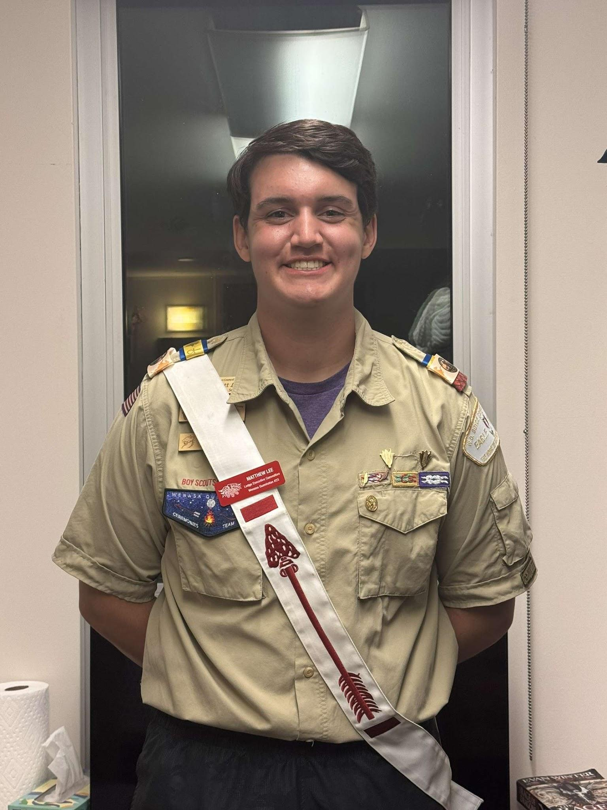

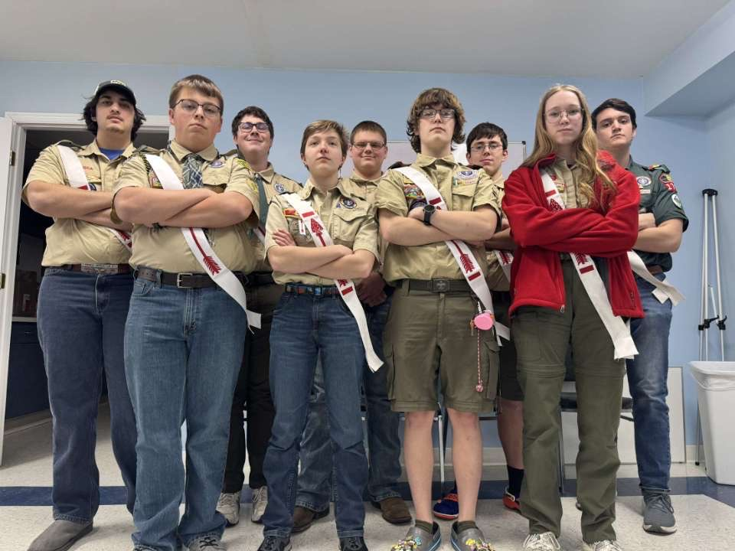
Meet Your LEC
Name:Matthew L.
Position:Treasurer
Why did you join the LEC?:
“I joined the LEC because I had some friends that encouraged me/gently forced me to join. At first I was very confused and nervous but now I’ve grown very accustomed to sharing my ideas.”
Favorite experience in the OA?:
“My favorite experience in the OA is so hard to choose because I love each event so much, but if I had to choose it would be Fall Fellowship when I did my brotherhood with several of my good friends. Doing it with them is a memory I won’t forget anytime soon.”
Why others should help on the LEC?:
“The LEC is a place for you to develop into a great leader. The life experience and practical skills are so valuable. You can do your part and give back to the lodge in such an impactful way and have the sense of self accomplishment by making the lodge better for your peers.”
WQ 4 U
WQ 4 U is our OA lodge leadership development. It will start on Friday, November 8th to the 9th. This fun packed weekend will help you build connections with fellow Arrowmen in our chapter and gain knowledge on how our lodge works. This is a free event that anyone is welcome to attend! Don’t miss out on this amazing weekend!
Chapter Meetings
Want to do even more fun activities outside of Lodge events? Check out your local chapter to see what events are coming up! Your chapters will have regular meetings to discuss affairs and to plan fun activities like lock-ins, bowing, and much more! Contact your Chapter Chief to learn when your next meeting is and get involved!
3

Slide 4
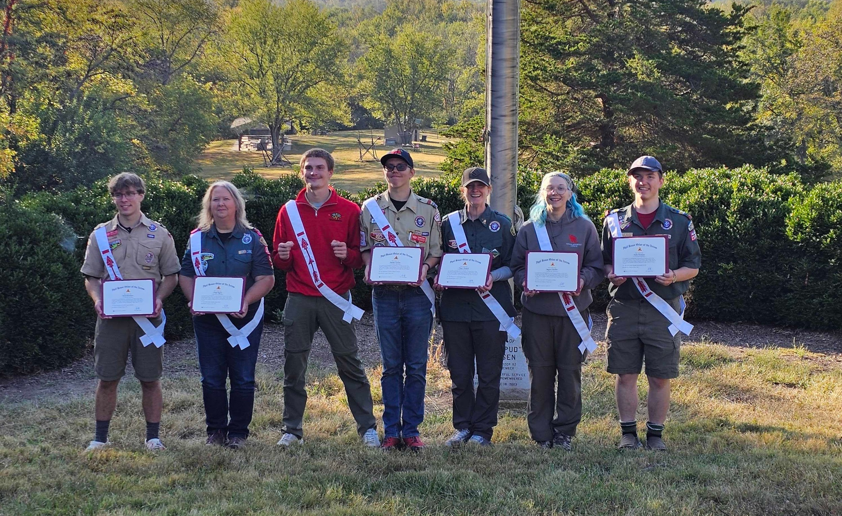
Recognition From Fall Fellowship
Be sure to congratulate our newest Ordeal and Brotherhood members the next time you see them!
Ordeal
Aubrey A. - Troop 5050
Alexandria A.- Troop 8888
Gregory A. - Troop 822
Andrew B. - Troop 920
Anthony C. - Troop 953
Elias C. - Troop 822
Elaina C. - Troop 9903
Ilario D. - Troop 225
Luke D. - Troop 1102
Jack E. - Troop 912
Quinn G. - Troop 2200
Nate G. - Troop 352
Clay G. - Troop 352
Brandon H. - Troop 931
Brennan H. - Troop 745
Jackson H. - Troop 903
Benjamin H. - Troop 931
Jon H. - Troop 931
Christian H. - Troop 115
Abigail H. - Troop 1155
Olive H. - Troop 8888
Gen J. - Troop 2200
Ben J. - Troop 352
Marshall J. - Troop 352
Walker J. - Troop 352
Liam J. - Troop 352
Penny J. - Troop 8888
Owen J. - Troop 225
Nathan L. - Troop 181
Latham L. - Troop 352
Brotherhood
Aiden A. - Troop 206
Brayden B -Troop 88
Samuel C. - Troop 57
Jonathan C. - Troop 1
Matthew D. - Troop 86
Keegan G. - Troop 2007
Charlie H. - Troop 155
Connor H. - Troop 65
Matthew H. - Troop 931
Xander J. - Troop 2142
David M. - Troop 2007
Steven M. - Troop 912
Logan Daniel L. - Troop 2007
Harper R. - Troop 8888
Victoria R. - Troop 888
Grant S. - Troop 178
Rebecca S. - Troop 178
Priscilla S. - Troop 5050
Alesha S. - Troop 8888
Greg S. - Troop 822
Cameron W. - Troop 1102
Brody M. - Troop 745
Conor M. - Troop 912
Eli M. - Troop 1122
Krissy M. - Troop 1122
Mason M. - Troop 1122
Aiden M. - Troop 206
Charlie M. - Troop 163
Frank N. – Troop 50
Landon P. - Troop 88
Grayson P.- Troop 919
Erin P. - Troop 957
Nolan P. - Troop 88
Thomas P. - Troop 88
William R. - Troop 967
Triston R. - Troop 822
Jacob R. - Troop 919
Nicolas R. - Troop 225
Caden R. - Troop 903
William R. - Troop 88
Caden S. - Troop 953
Griffin S. - Troop 64
Thomas S. - Troop 64
Will S. - Troop 225
Hayden S. - Troop 50
Emma S. - Troop 888
Annabell S. - Troop 2200
Kim S.- Troop 2200
Kimberly T. - Troop 2142
Anne T. - Troop 206
Emily E. - Troop 2206
Isabel U. - Troop 888
Nathan V. - Troop 352
Zachary W. - Troop 1
William W. - Troop 919
Jim W. - Troop 1091
Vigil
David S. - Troop 165
Cindy R. - Crew 1791
Jonathan K. - Troop 919
Zander C. - Troop 1142
Ginger H. - Troop 912
Meg L. - Troop 9903
Aiden H. - Troop 181
Congratulations to everyone that completed their Vigil
4

Slide 5



Follow Our Social Medias!
Wenasa Quenhotan has multiple social media platforms where we post updates on lodge events, awards, etc. If you want to see pictures from fall fellowship, see people who were tapped out for the Vigil Honor, and more follow our socials. You can reach both Facebook and Instagram at wq23oa. Go follow!
The Newsletter is going Digital!
After a long debate in the LEC, we have decided to stop sending the newsletter starting 2026. The newsletter will still be made, but it will be posted digitally on the lodge website. To find these newsletters go to wq23.org, click on the menu button, and then click on The Arrow Newsletter. There you will find the newsletters every fall, winter, and spring!
Here Are Your Lodge Officers and How to Contact Them
Position | Name | Phone | Email
Lodge Chief | Conner M. | (309) 713-6393 | lodgechief@wq23.org
Lodge Vice Chief | Matthew L. | (309) 214-1321 | lodgevicechief@wq23.org
Lodge Treasurer | Zander C. | (309) 620-1590 | lodgeadvisor@wq23.org
Lodge Secretary | Becca H. | (309) 831-8111 | lodgesecretary@wq23.org
District Name | Chapter Name | Chapter Chief | Phone | Email
Heartland | Lawasgoteu | Sofia M. | (309) 989-0751 | lawasgoteu@wq23.org
Lowaneu | Lowaneu | Vacant | (779) 732-0103 | lowaneu@wq23.org
Crossroads | Mattameechen | Elijah A. | (309) 336-4815 | mattameechen@wq23.org
Wotamalo | Wotamalo | Daniel S. | (309) 613-5550 | wotamalo@wq23.org
5

Slide 6

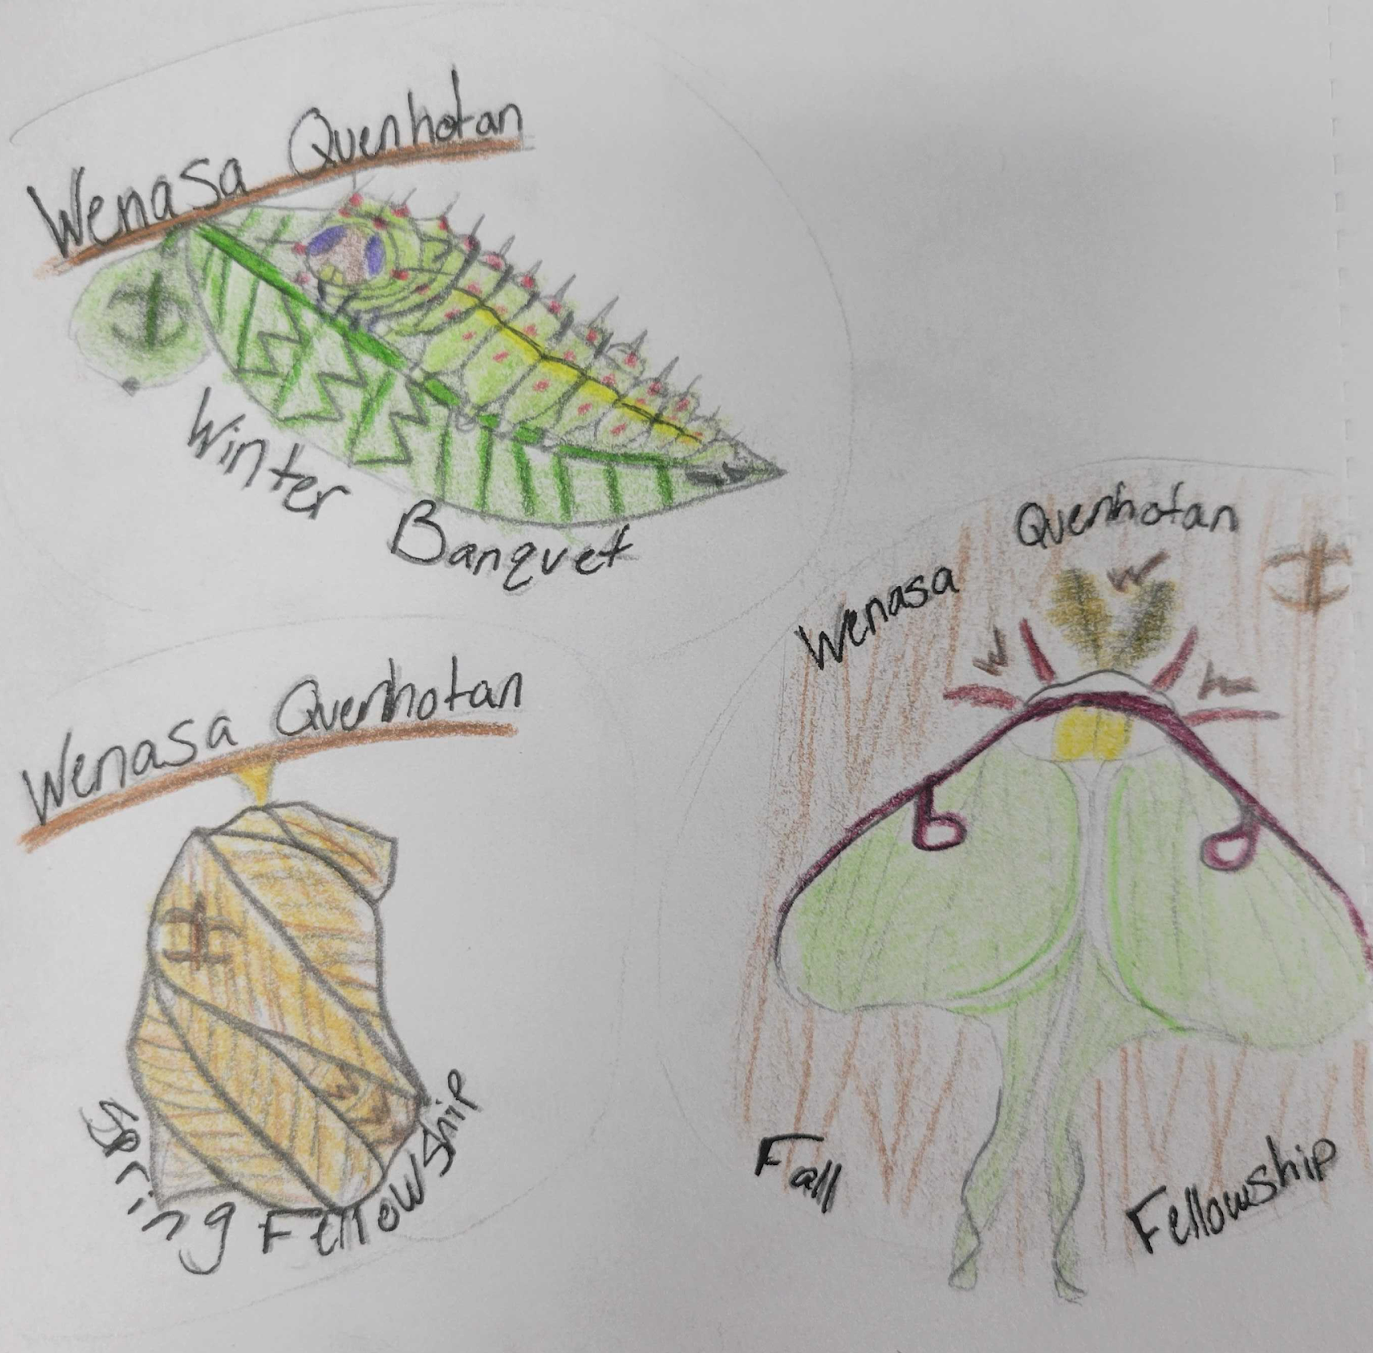
The Golden Kernel
Do you attend all 3 lodge events. Winter Banquet, Spring Fellowship and Fall Fellowship. Would you like to attend them for a cheaper rate? Well if so Golden Kernel is just the thing for you. Sign up for all 3 big lodge events plus paying your dues now for a cheaper rate. You also get the coolest golden kernel pin. So don't miss this deal sign up Now!
Artist In residence patches
Take a look at the amazing patches Meg L. made for our lodge! Each of these patches represent a specific event in our lodge! You will get one after fall fellowship, one after winter banquet, and the last after spring fellowship. Show up to all these events and collect the full set amazing patches that Meg made for us!
Upcoming Events
Here is a list of the upcoming Lodge events that will be happening in 2025-2026.
Winter Banquet: Jan 3rd, 2026
Spring Fellowship: May 1st -3rd, 2026
For more information on these events go to wq23.org There you will find in depth descriptions and registration for all upcoming events!.
Join the Lodge Executive Committee
Interested in helping lead our lodge? Then you should join the Lodge Executive Committee! The LEC is a group of individuals made up of all ages, that help our lodge run smoothly. All are welcome to join. You need no prior experience to join, just an interest in helping our lodge. Check out wq23.org for vacant positions and more information on the LEC.
6

Slide 7
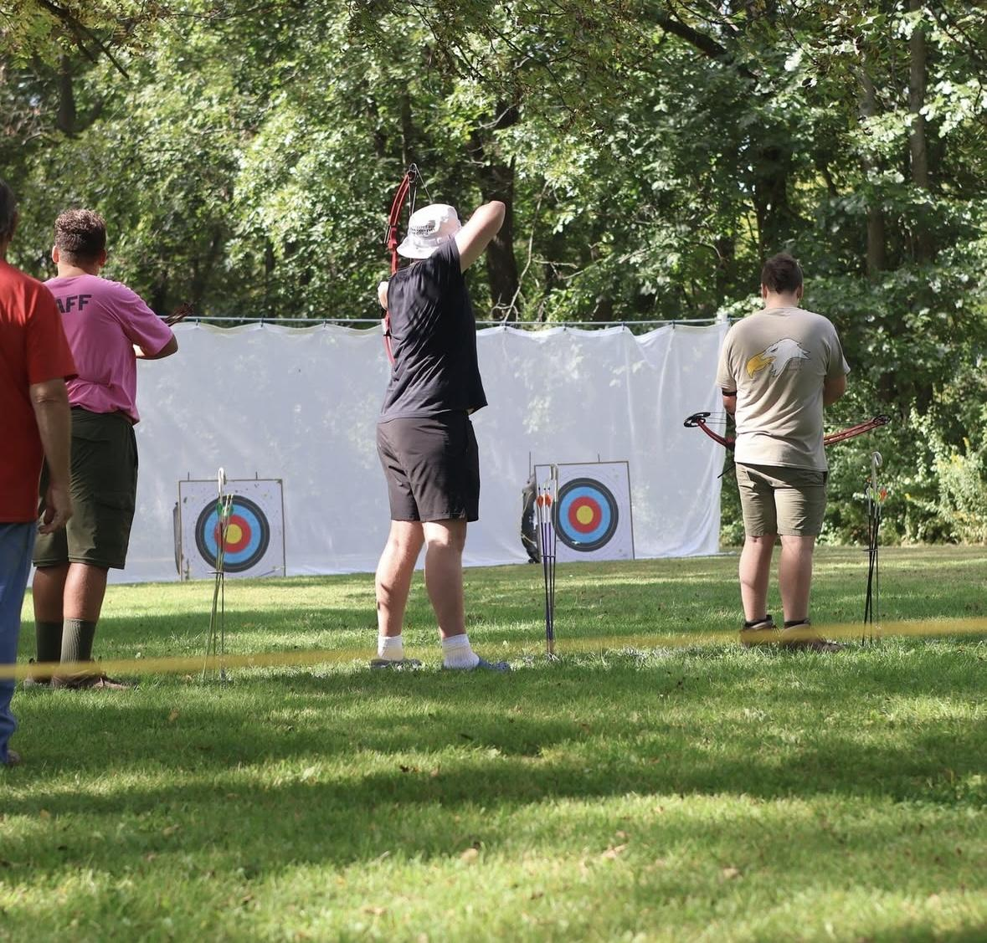
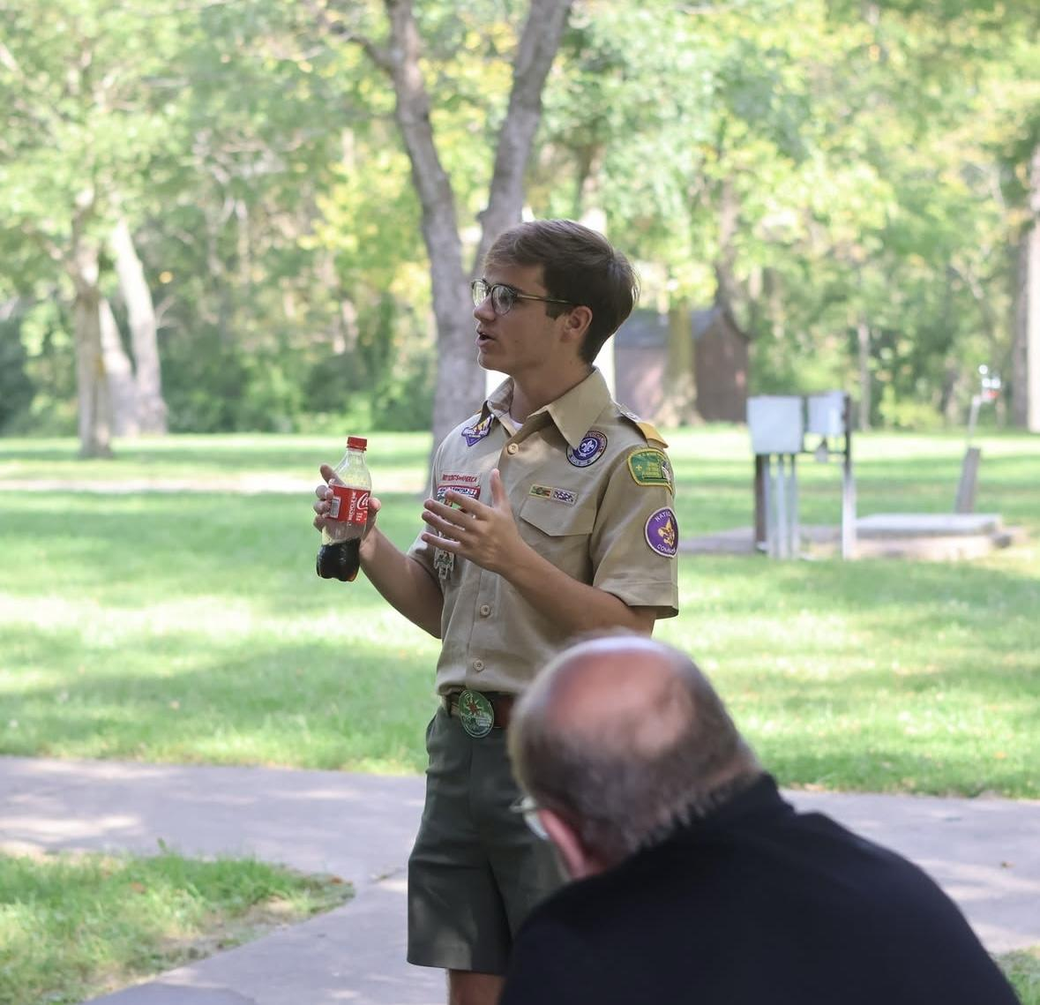
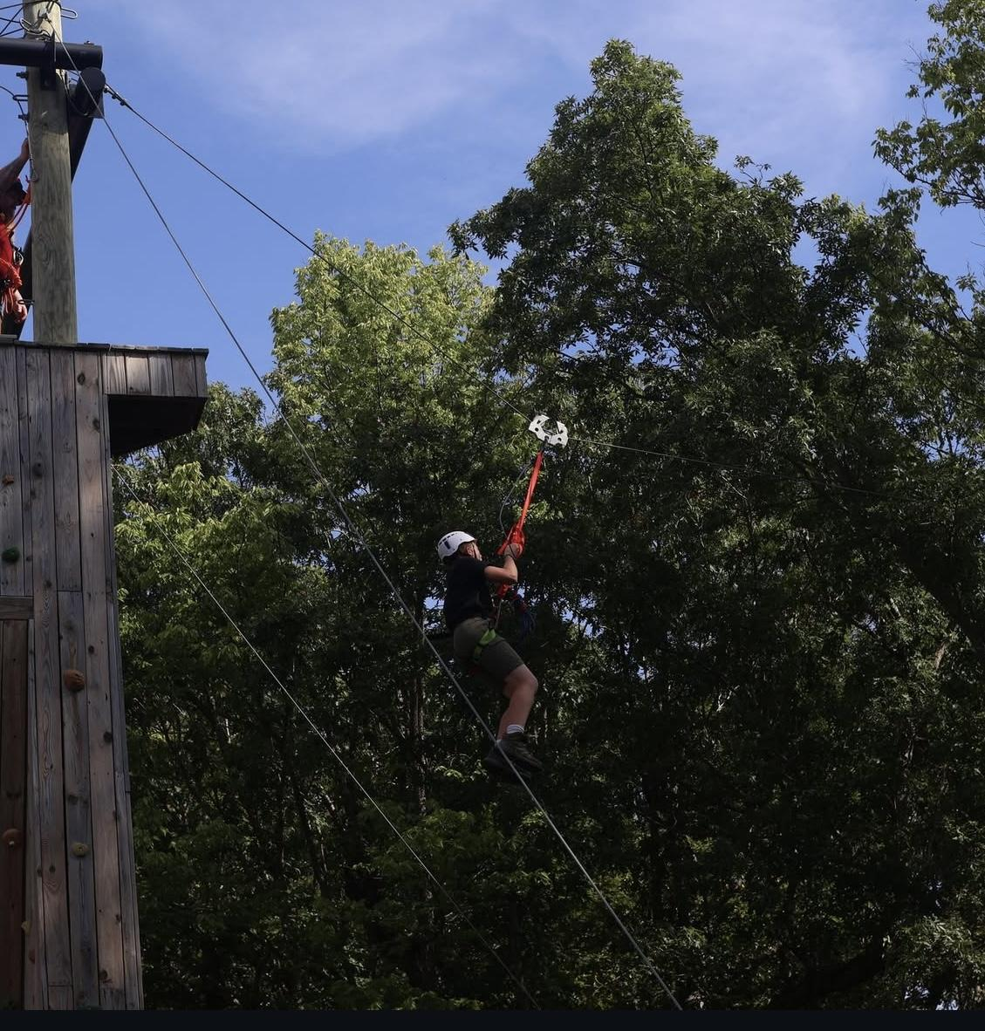
Red Arrow Rally (RAR)
There was recently an event held at Loud Thunder Scout Reservation called Red Arrow Rally (RAR). Red Arrow Rally is similar to a camporee, but instead of all of the troops from a council, it’s all of the lodges from a section. Our section is G8, and roughly 150 arrowmen from across the section gathered to “Groove Through the Storm.” Some activities were basketry, dance lessons, bracelet making, cowboy action shooting, and blind fold tent pitching. Our very own lodge won the “Thunder-jack” award, a lodge vs lodge competition! Along with all the fun, there were also trainings available to learn more about the section and understand your personal role in the OA. If this all sounds super exciting, then you’re gonna be over the moon to hear that the next RAR will be held at your very own ISR NEXT YEAR! It sure will be a weekend to remember, and we’ll need all the help we can get to make it happen! Stay tuned for more info coming soon!
Arrowman participating in archery
Ben J giving a speech
Arrowman enjoying ziplining
Winter Banquet 2026!
Winter banquet is coming up and you don’t want to miss out! Winter banquet is a fun time of fellowship with our whole lodge. During this time we eat food, give awards, and celebrate our year of service! There will also be a silent auction, trading post, vigil recognition and so much more. Winter Banquet is January 3 at Asmark Institute Training Center in Bloomington. Look for more information on wq23.org and register for Winter Banquet!
Lodge Dues
Do you love fun and fellowship? If so make sure to stay on top of your dues. Lodge dues are so important to receive emails and newsletters and to stay on top of all the fun. Make sure you stop by the website to pay your dues so you don't miss out on all the fun and fellowship.
7

Slide 8




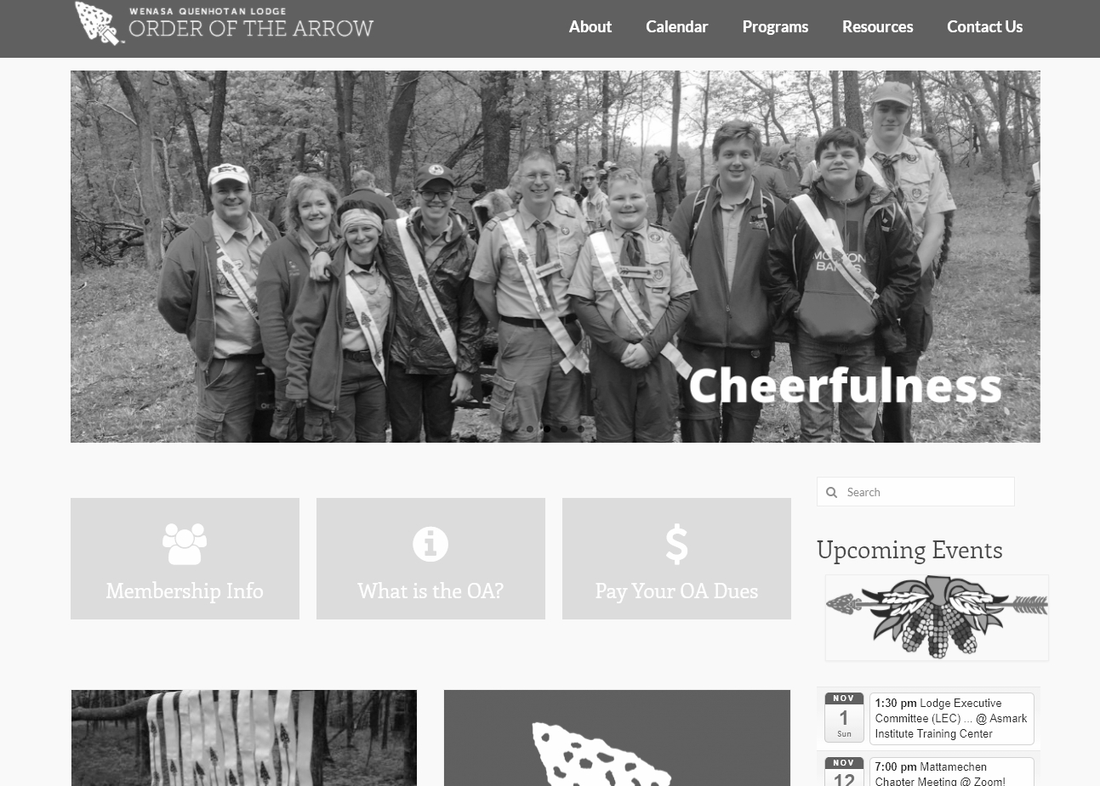
NON-PROFIT ORG
U.S. Postage
PAID
Peoria, IL
Permit No.611
Address Service Requested
facebook.com/wq23oa
@wq23oa
@wq23oa
Check out the Lodge website:
www.wq23.org
Renew your membership to receive future issues of the Arrow & other Lodge information!

